Slide 1

EEVMC: An Energy Efficient Virtual Machine Consolidation Approach for Cloud Data Centers
School of Computer Science and Engineering
Department of Computer Science and Engineering
SUBMITTED BY :
JAY PRATAP SINGH TOMAR
2427030179
SUPERVISED BY:
DR. MANMOHAN SHARMA

Slide 2
Outline
Introduction
Literature Review
Problem Statement
Objectives
Proposed Methodology
Result
Outcome
References

Slide 3
Introduction
Cloud computing provides scalable access to computational resources.
Rising workload demand has increased energy usage in data centres .
VM consolidation shuts down idle hosts to reduce power consumption.
Challenge: conserve energy without performance degradation.
EEVMC attempts to solve this with an intelligent placement framework.

Slide 4
Literature Review (1)
VM consolidation classified as NP-hard due to combinatorial placement complexity.
Classical methods: Best Fit, First Fit, MBFD, PABFD.
Heuristic extensions improve energy efficiency using scoring models.
Meta-heuristics like GA, PSO, ILP optimize placement at higher cost.
ML-based models predict workload fluctuations for better decisions.

Slide 5
Literature Review (2)
MBFD and PABFD effective for static workloads but fail under spikes.
PEFFD and MFPED introduce host-efficiency scoring for improved balance.
Deep learning models help forecast CPU demand and avoid overload.
Reinforcement learning frameworks learn optimal placements over time.
Despite progress, computational complexity remains a barrier.

Slide 6
Problem Statement
Cloud data centres face rising energy consumption and operational cost.
Inefficient VM placement triggers host overload and SLA violations.
Existing techniques lack adaptability to dynamic workloads.
A balanced, scalable and efficient VM consolidation strategy is required.
EEVMC aims to minimize energy loss while maintaining stable performance.

Slide 7
Objectives
Minimize overall energy consumption across cloud hosts.
Reduce SLA violations occurring due to overutilization.
Enhance average host utilization through balanced workload placement.
Lower VM migration frequency to reduce network overhead.
Develop a loss-based multi-factor evaluation strategy.

Slide 8
Proposed Methodology
Uses Loss-Aware Performance Efficient Decreasing (LAPED) approach.
Evaluates active and inactive hosts using a unified loss metric.
Loss metric includes CPU usage, power ratio, and activation cost.
Selects the host with minimum loss value for VM placement.
Reduces unnecessary migrations and improves SLA stability.

Slide 9
Proposed Methodology step 1: host monitoring
Monitor CPU utilization of all hosts
Identify underutilized and overutilized hosts
Analyze workload behavior
To improve resource allocation

Slide 10
Proposed Methodology Step 2: Loss-Aware Host Selection
Evaluate host energy efficiency
Select optimal host for VM placement
Minimize power consumption
EEVMC introduces loss-aware host selection criteria

Slide 11
Proposed Methodology Step 3: VM Consolidation
Migrate VMs from inefficient hosts
Consolidate workloads efficiently
Shut down unused servers
Benefits:
Reduced energy consumption
Improved efficiency

Slide 12
Proposed Methodology Step 4: Performance Optimization
Reduced VM migrations
Reduced SLA violations
Improved system stability
Improved host utilization

Slide 13
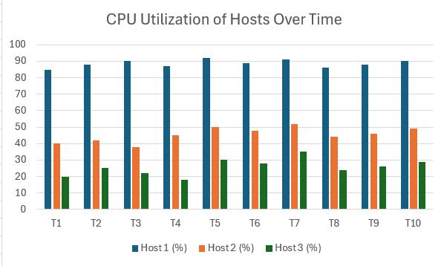
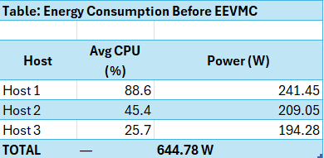
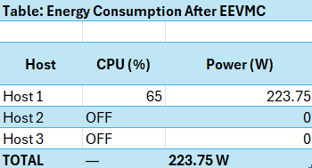
result

Slide 14
outcome
Successfully studied and analyzed the EEVMC (Energy Efficient Virtual Machine Consolidation) algorithm for cloud energy optimization
PlanetLab workload dataset integrated to simulate real-world cloud CPU utilization

Slide 15
References
Rehman et al. (2024): EEVMC energy-efficient consolidation model.
Moges & Abebe (2019): Energy-aware VM placement algorithms.
Medara (2023): Dynamic VM Consolidation techniques.
Beloglazov & Buyya (2011–2012): Power-aware cloud data center optimization.
Arshad et al. (2022): SLA reduction through dynamic consolidation.

Slide 16
Thank You
End of Presentation.
Open for evaluation and discussion.

